Slide 1
Orion Bus Industries
Group- 7

Slide 2
Introduction
Orion is a urban transit bus manufacturer that supplies buses to transit authorities across North America.
Contracts to supply buses were done based on bidding
Two bid types were used:
low tender bid : manufacturer could submit a bid and the lowest bid that met the technical specifications of the buyer was given the supply contract
negotiated bid : exceptions to the technical specifications of the buyer could be submitted with the bid and the lowest technical compliant bid would normally be given the supply contract

Slide 3
Case Goal:
Build model to predict winning bid.
State advantages and disadvantages of the model
Predict bid for 5, 30’ LF D based on Orion’s estimated cost of $234,229 per bus.

Slide 4
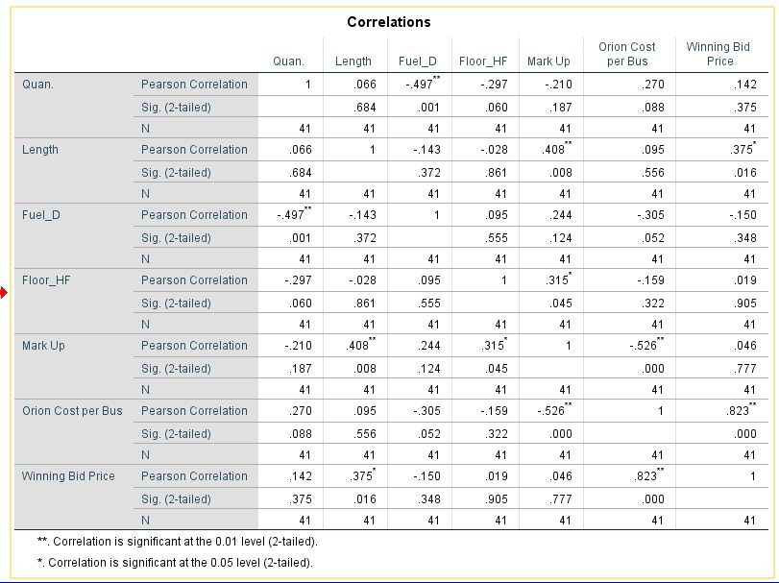

Slide 5
Build a model that will help Orion to predict winning bids and allow the company to maximize total contribution (profit).
 | Coefficients | Standard Error | t Stat | P-value | Lower 95% | Upper 95% | Lower 95.0% | Upper 95.0%
Intercept | -14925.2526 | 26475.04663 | -0.56375 | 0.576520306 | -68672.45433 | 38821.95 | -68672.5 | 38821.9491
Quan. | 19.16520501 | 222.0966562 | 0.086292 | 0.931725935 | -431.7149747 | 470.0454 | -431.715 | 470.045385
Length | 1971.518928 | 461.6492426 | 4.270599 | 0.000141732 | 1034.321147 | 2908.717 | 1034.321 | 2908.71671
Fuel_D | 10455.80337 | 6229.708249 | 1.678378 | 0.102181902 | -2191.176656 | 23102.78 | -2191.18 | 23102.7834
Floor_HF | 8678.806066 | 4407.791922 | 1.968969 | 0.056914615 | -269.4872037 | 17627.1 | -269.487 | 17627.0993
Orion Cost per Bus | 0.859422211 | 0.078641582 | 10.92834 | 7.90109E-13 | 0.699771312 | 1.019073 | 0.699771 | 1.01907311

Slide 6
Winning Bid = -14925.25 + 19.16 (Number Of Buses In Contract) + 0.859 (Orions Estimated Cost) + 1971.51 (Length) + 10455.8 (Diesel) + 8678.80 (High Floor) + ε

Slide 7
Advantages and Limitations of Model
Pros:
Our model is simple to understand
The company can potentially improve their win percentage.
Good interpretability
Cons:
Even though the p-value was not significant among variables, yet we considered these in our model as they drove our prediction.
Prone to outliers
Drawbacks as any other forecasting model , since we are trying to forecast bid.

Slide 8
The city of Louisville, Kentucky is interested in purchasing five 30-foot, low-floor, diesel-fuelled buses. As the vice-president of sales for Orion, how much would you bid for this contract, based on Orion’s estimated cost of $234,229 per bus?
Winning Bid = β0 + β1 Number Of Buses In Contract + β2 Orions Estimated Cost + β3 Length + β4 Diesel + β5High Floor + ε
Taking the following factors into consideration: Intercept, Quan., Length, Fuel_D, Floor_HF, Orion Cost per Bus
y_{i} = -14925.25 + 19.16 * 5 + 1971.51 * 30 + 10455.80 * 1 + 8678.80 * 0 + 0.8594 * 234229
y_{i} = $256,073.55

Slide 9
Bidding Price | Mark Up | P(lose) | P(win) | expected profit
243000.00 | 8771.00 | 0.14 | 0.86 | 7586.06
244000.00 | 9771.00 | 0.15 | 0.85 | 8263.59
245000.00 | 10771.00 | 0.18 | 0.82 | 8884.26
246000.00 | 11771.00 | 0.20 | 0.80 | 9442.99
247000.00 | 12771.00 | 0.22 | 0.78 | 9935.08
248000.00 | 13771.00 | 0.25 | 0.75 | 10356.32
249000.00 | 14771.00 | 0.28 | 0.72 | 10703.15
250000.00 | 15771.00 | 0.30 | 0.70 | 10972.80
251000.00 | 16771.00 | 0.33 | 0.67 | 11163.41
252000.00 | 17771.00 | 0.37 | 0.63 | 11274.13
253000.00 | 18771.00 | 0.40 | 0.60 | 11305.17
254000.00 | 19771.00 | 0.43 | 0.57 | 11257.88
255000.00 | 20771.00 | 0.46 | 0.54 | 11134.75
256000.00 | 21771.00 | 0.50 | 0.50 | 10939.38
257000.00 | 22771.00 | 0.53 | 0.47 | 10676.41
258000.00 | 23771.00 | 0.56 | 0.44 | 10351.46
259000.00 | 24771.00 | 0.60 | 0.40 | 9970.97
260000.00 | 25771.00 | 0.63 | 0.37 | 9542.08
261000.00 | 26771.00 | 0.66 | 0.34 | 9072.44
262000.00 | 27771.00 | 0.69 | 0.31 | 8570.03
263000.00 | 28771.00 | 0.72 | 0.28 | 8043.00
264000.00 | 29771.00 | 0.75 | 0.25 | 7499.43
265000.00 | 30771.00 | 0.77 | 0.23 | 6947.17
266000.00 | 31771.00 | 0.80 | 0.20 | 6393.69
267000.00 | 32771.00 | 0.82 | 0.18 | 5845.93
The bidding price $253000 has the maximum expected profit of 11305.17 with a good chance of wining the bid.

Slide 10
Recommendations:
Priority should be given to produce buses that will fulfill existing commitment , because track record implies higher probability of winning a contract
2 Production in categories with high mark-up potential and high probability of winning contract
Next they should consider production of buses with high markup potential but lower probability of winning contract

